Slide 1


ECEN 403 Final Presentation Team 63 – AWG Leandro Bracho, Oscar Medrano, Nick Joseph, and Robin Smithson Sponsor: Professor John Lusher

Slide 2
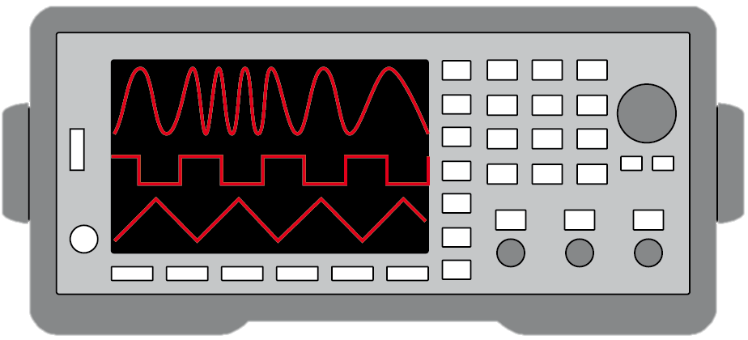
Project Description
Problem Statement:
Test validation is a vital step in the design and fabrication of circuit boards for any project in the realm of electrical engineering.
Typical AWGs can be large and unintuitive
Solution Proposal:
Create a mobile user interface for the AWG
Design an AWG with decent quality
Allow hand drawn waveforms
Notes:
Nick

Slide 3
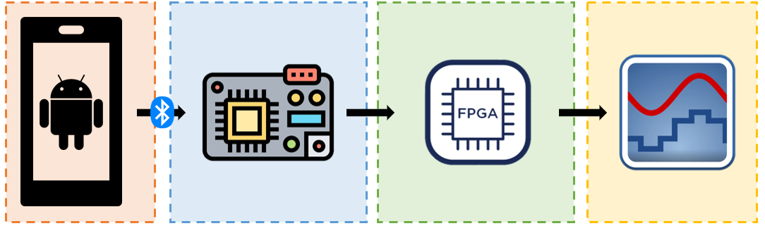
Subsystem Overview
Leandro Bracho | Robin Smithson | Nick Joseph | Oscar Medrano
Android Application | Microcontroller | FPGA | DAC
Notes:
Robin (or Leandro or Oscar)

Slide 4
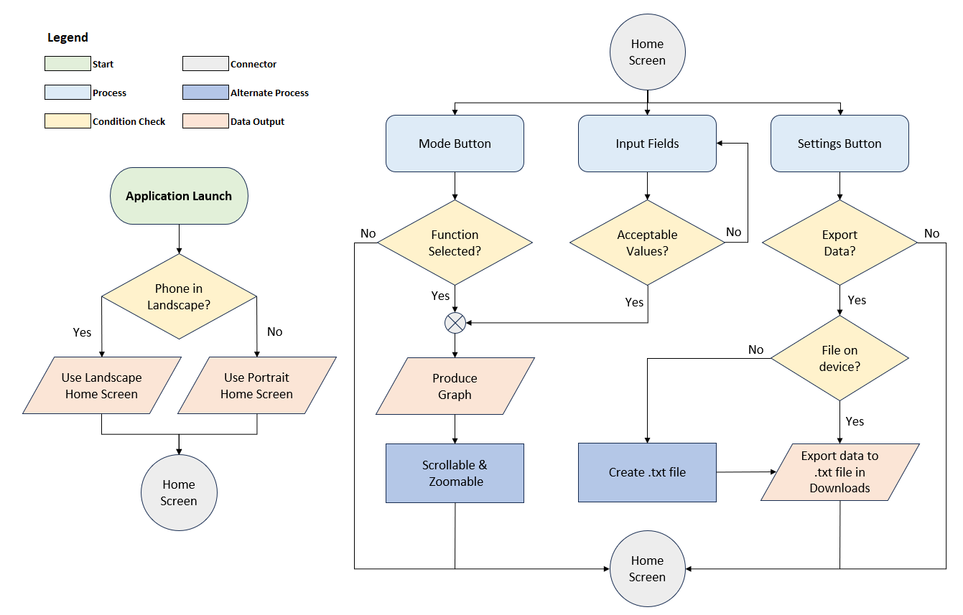
Android Application Flowchart

Slide 5
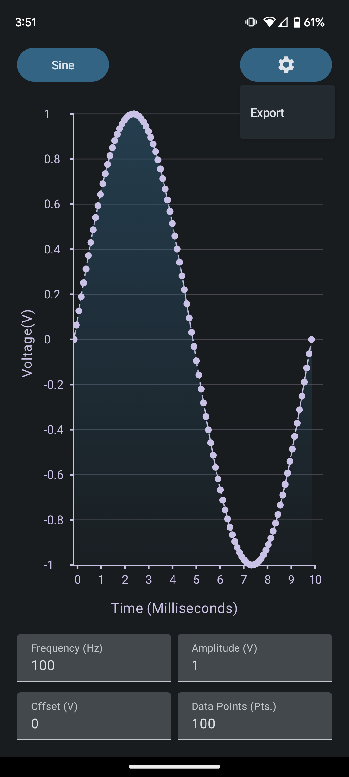
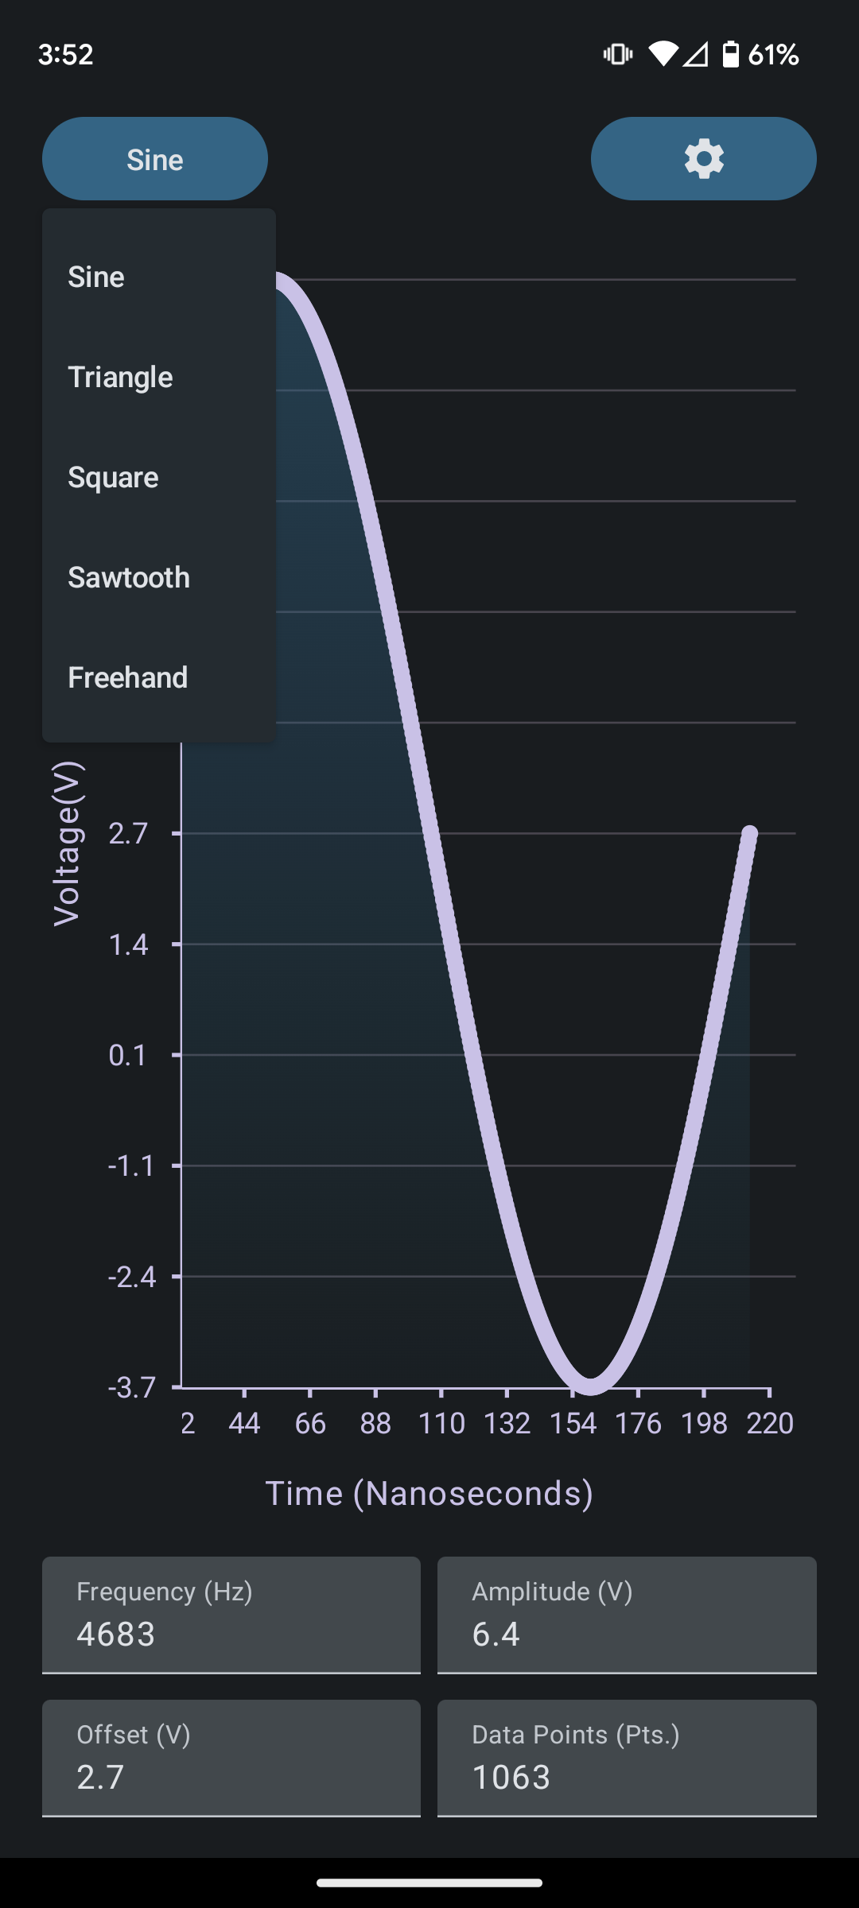
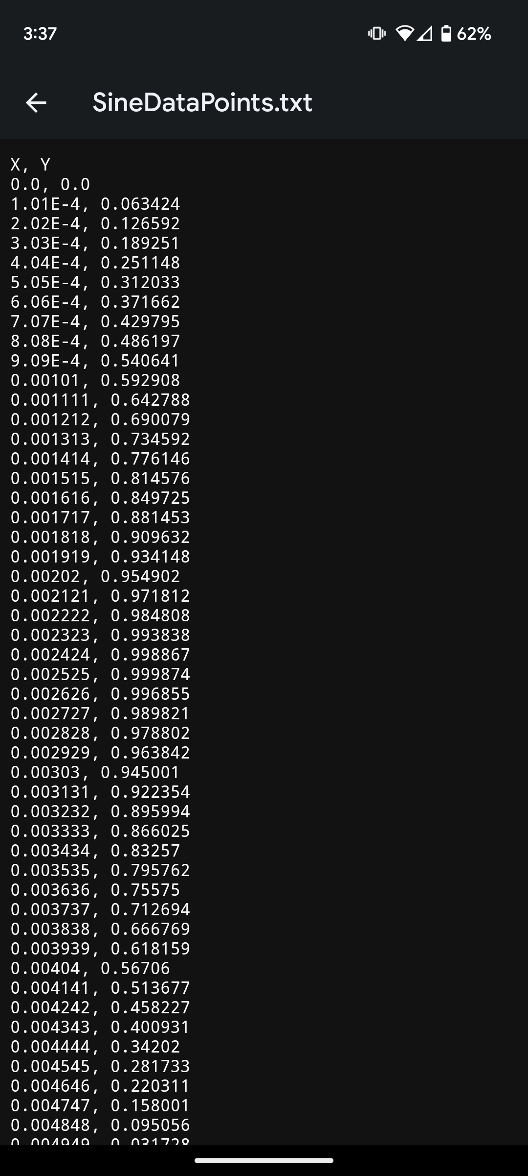
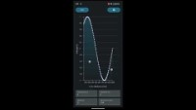
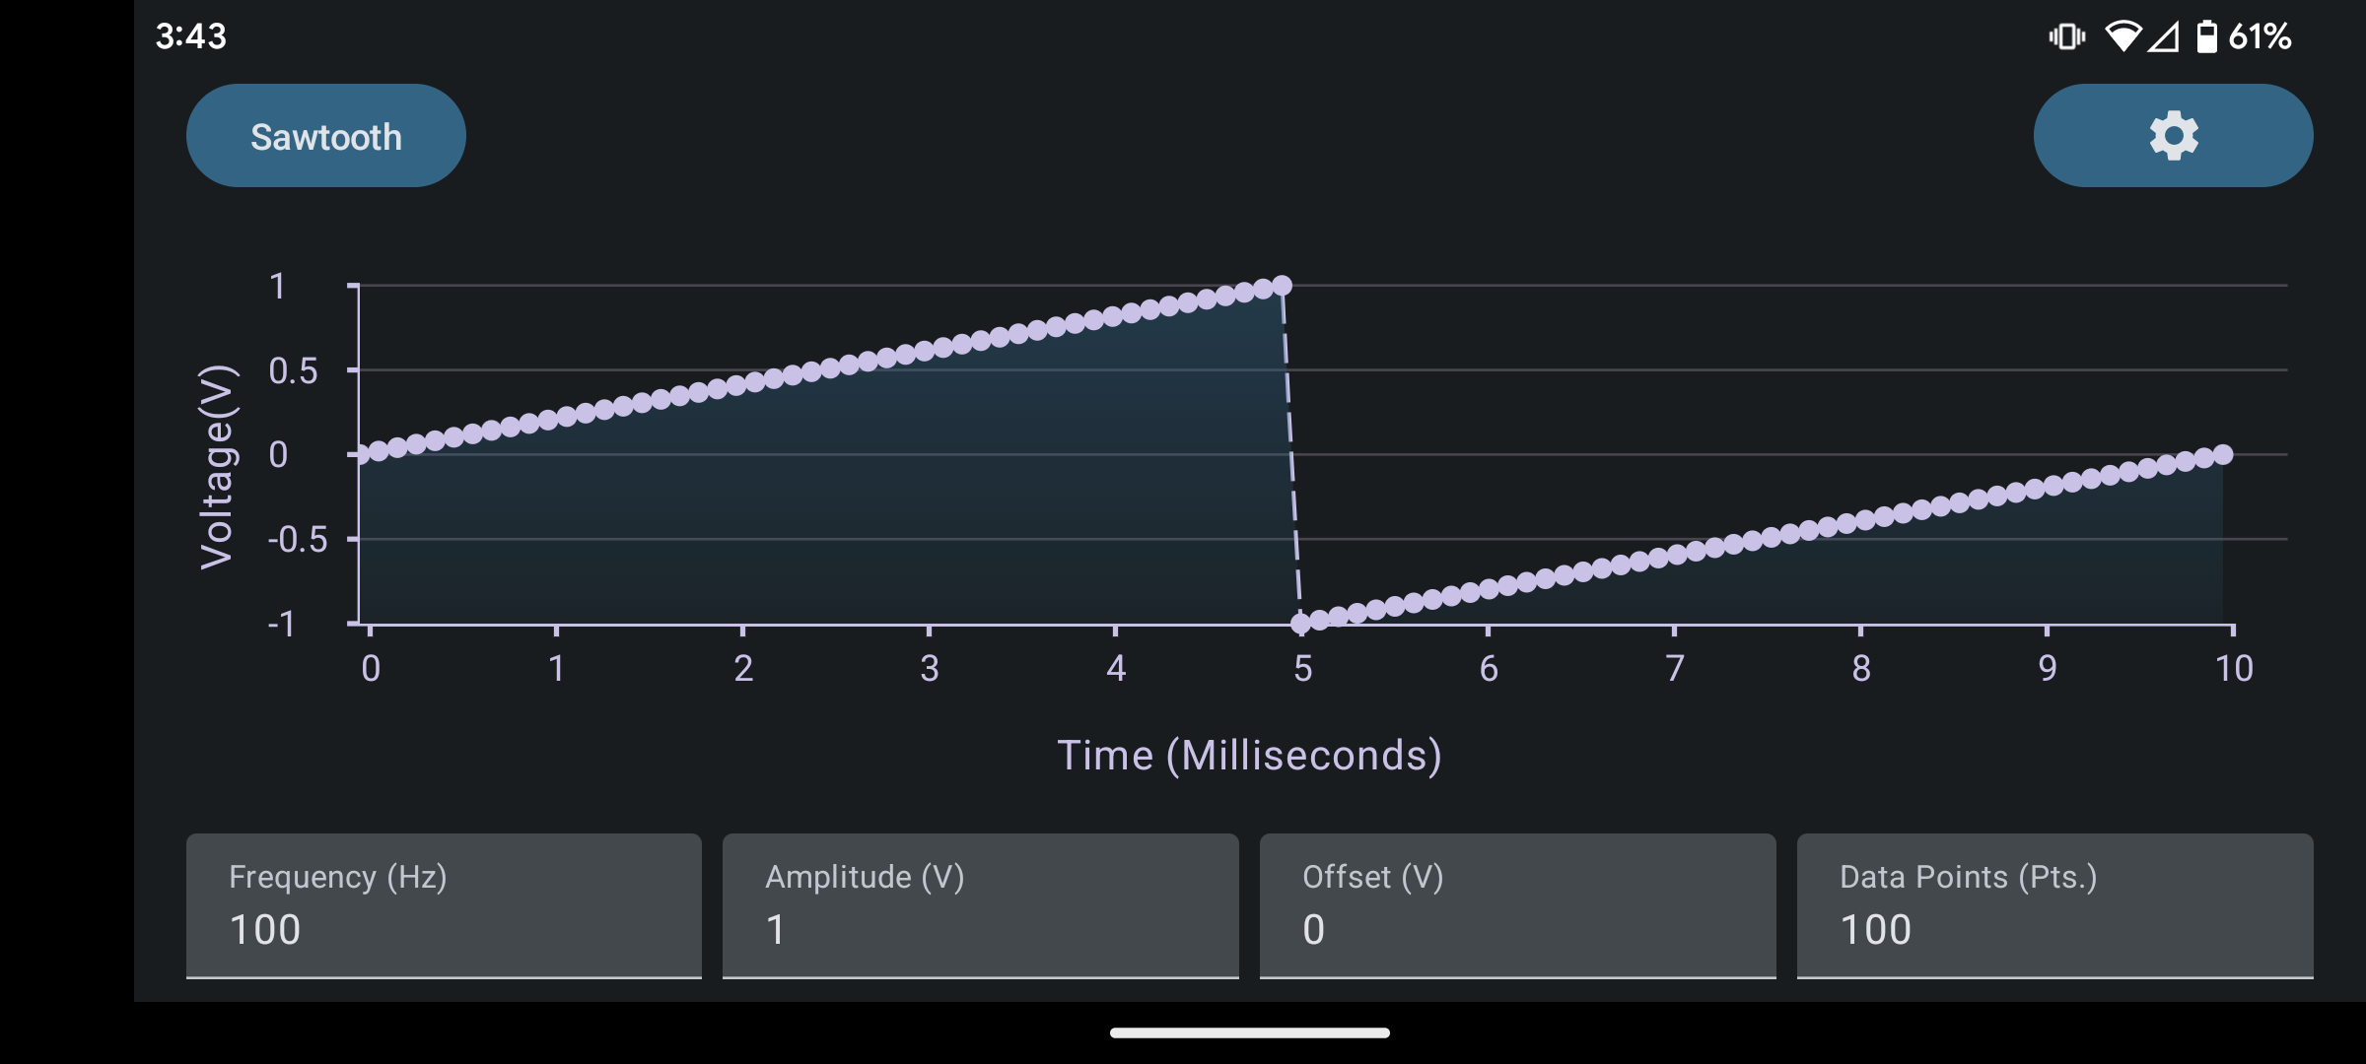
Android Application
Video Link: https://youtu.be/ER6whhiBOCw?si=KfntIzJiZYk1K7D2
Notes:
Video Link: https://youtu.be/ER6whhiBOCw?si=KfntIzJiZYk1K7D2

Slide 6
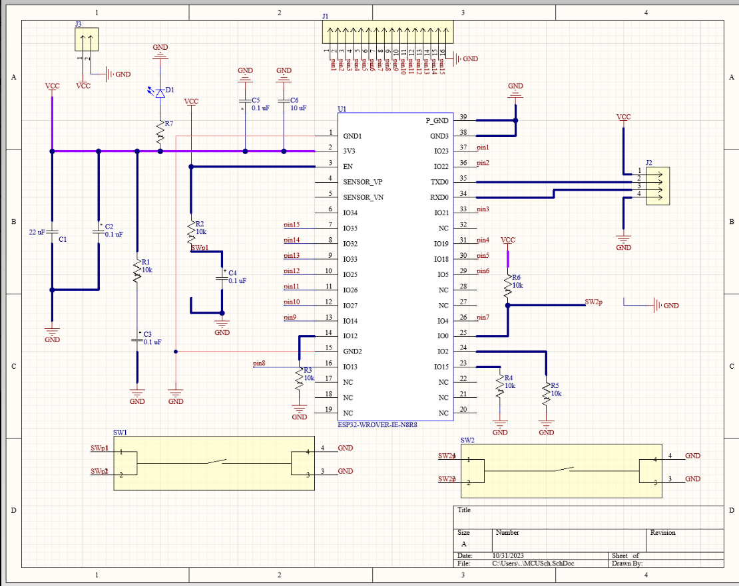
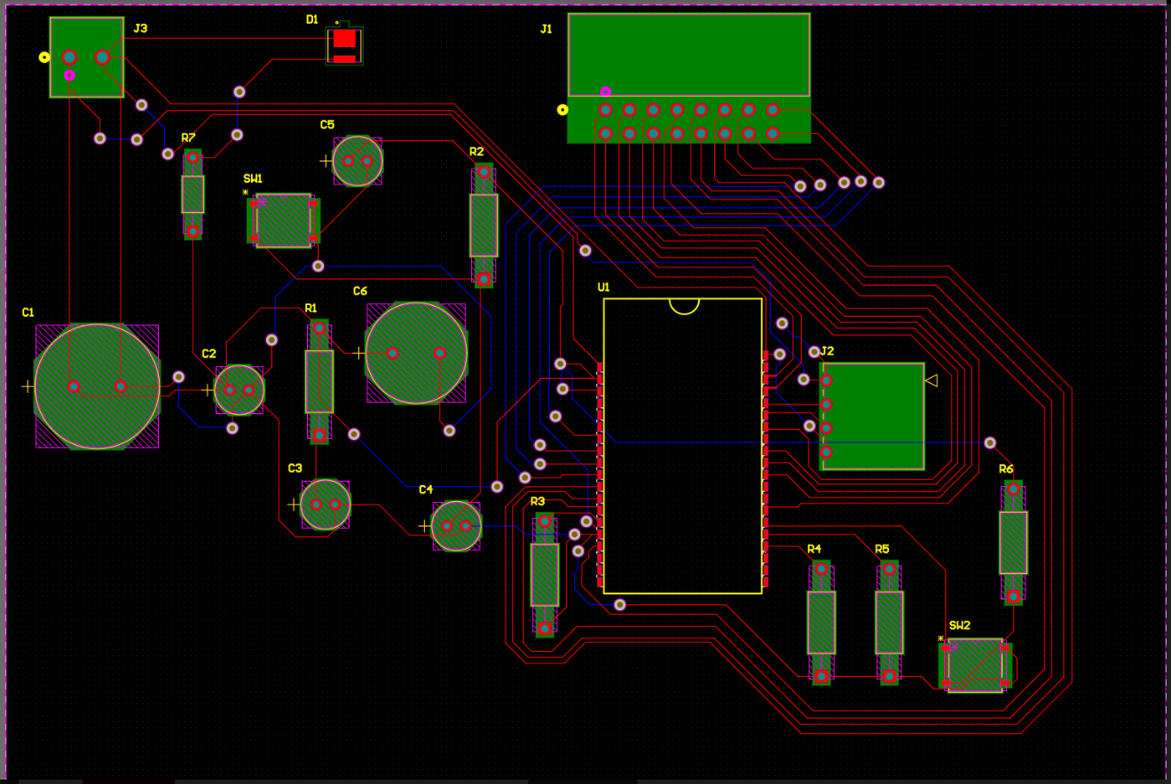
Microcontroller

Slide 7
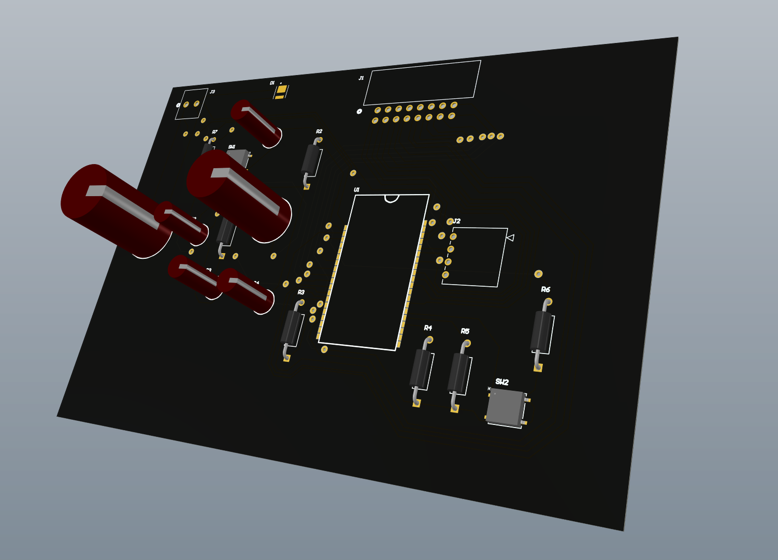
Microcontroller

Slide 8
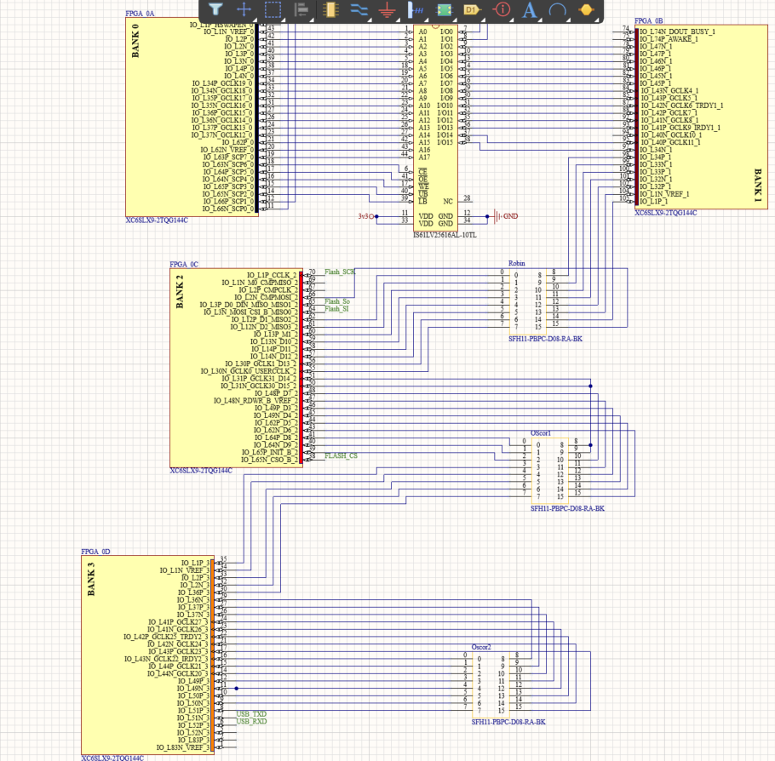
FPGA

Slide 9
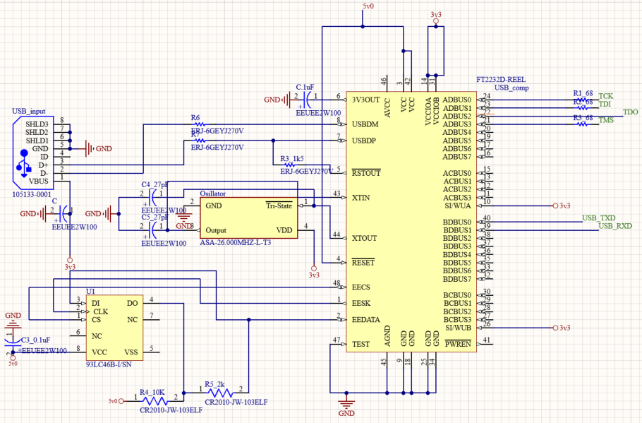
FPGA

Slide 10
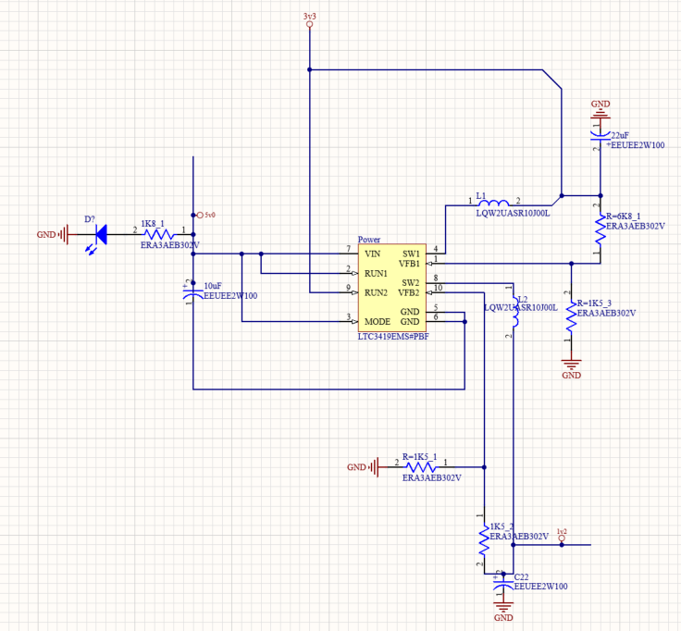
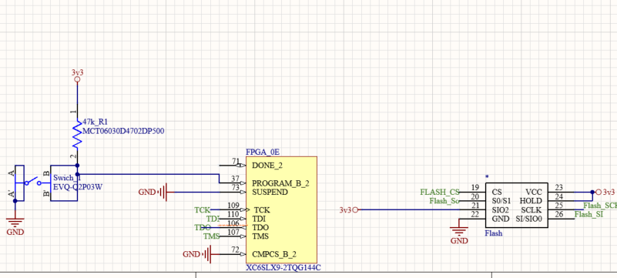
FPGA

Slide 11
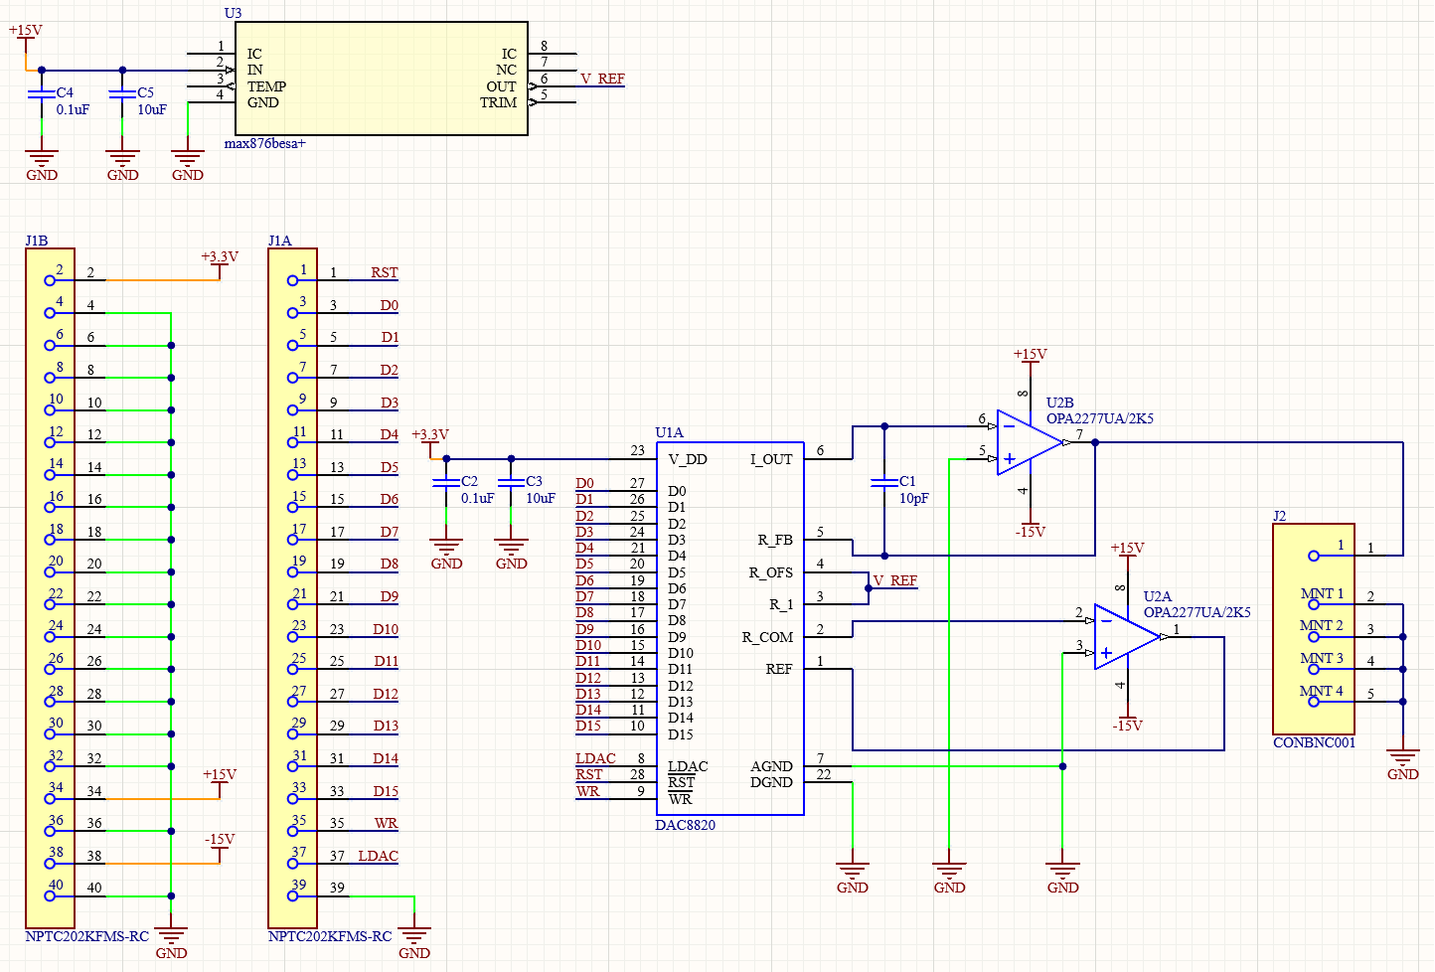
Bipolar Output Circuitry Design

Slide 12
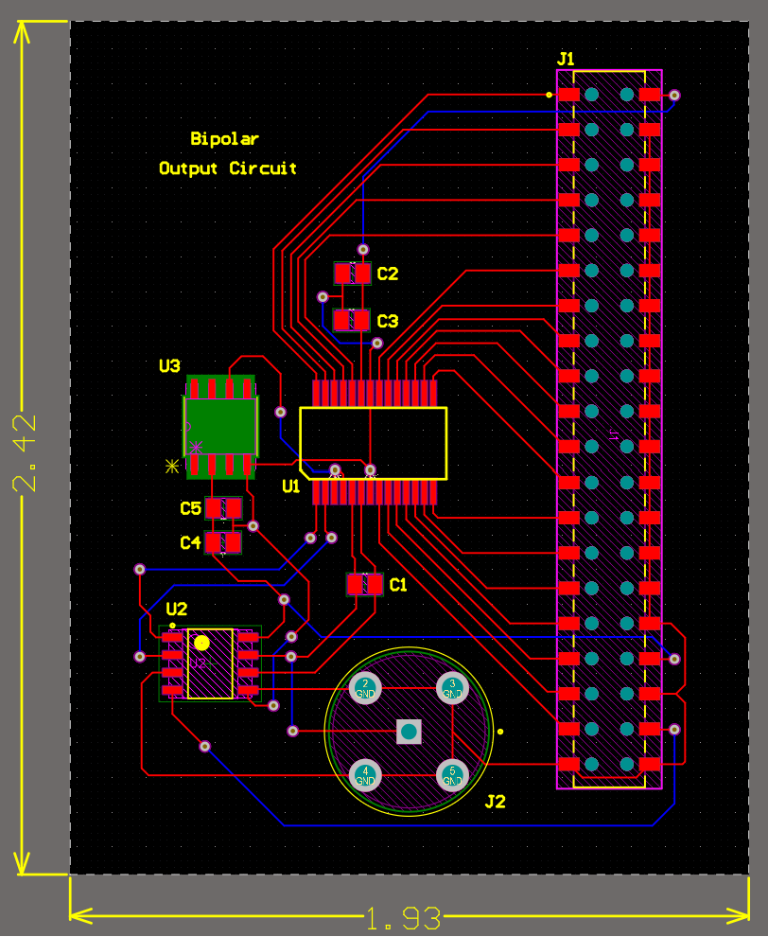
Bipolar Output Circuitry Testing and Validation
Planning on testing with an Analog Discover 2
Input data and get a desired wave. (Sine, Triangular, Square, and Sawtooth)
Testing for total voltage range, looking for ±10V.

Slide 13
Android Application Execution Plan
 | Sep-25 | Oct-2 | Oct-9 | Oct-16 | Oct-23 | Oct-30 | Nov-6 | Nov-13 | Nov-20 | Nov-27 | Dec-4
Design App UI |  |  |  |  |  |  |  |  |  | Not Started
Create Text Fields |  |  |  |  |  |  |  |  |  | In Progress
Add User Input |  |  |  |  |  |  |  |  |  | Completed
Implement Buttons |  |  |  |  |  |  |  |  |  | Behind Schedule
Integrate Waveform Window
Write Wave Functions
Add Data Export
Create Freehand Function
Stress Test Application

Slide 14
Android App Validation Plan
Paragraph # | Test Name | Success Criteria | Methodology | Status
3.2.1.1 | User Interface | The UI appears correctly in portrait and landscape orientation. | On app homepage check for visual errors in portrait orientation, then flip to landscape and check again. | SUCCESS
3.2.1.1 | Buttons | Each button is clickable with a working dropdown menu | Each button subsequent dropdown item will be pressed, and their options should perform its task | SUCCESS
3.2.1.2 | Wave Functions | Each wave can be selected and outputs their respective graphs correctly | Each function will be selected and given preset data and user input data to test if the wave outputs correctly | SUCCESS
3.2.1.2 | User Input | Users can input data and only the acceptable values are passed on | A range of numbers and special characters will be passed into the inputs | SUCCESS
3.2.1.2 | Freeform Mode | A user can draw a wave and the wave's properties appear in the data fields | The mode will be selected, and a wave will be drawn to test if the input field's values are updated | UNTESTED
3.2.1.2 | Export | File is exported, saved locally on device, and contain correct data points. | Data will be exported, the downloads folder will be checked, and the file will contain its expected values | FAILED
3.2.3.2.1 | Bluetooth | The app can successfully pair with the MCU | The device will connect to the MCU and the MCU should appear in the phone's "Connected Devices" | UNTESTED

Slide 15
MCU Execution
 | Sep-25 | Oct-2 | Oct-9 | Oct-16 | Oct-23 | Oct-30 | Nov-6 | Nov-13 | Nov-20 | Nov-27 | Dec-4
Create and Finalize MCU Schematic
Order Microcontroller Parts
Order PCB & Solder Components
Establish Bluetooth Connection
Import Sample Data
Program Clock Rate
Export Sample Data

Slide 16
MCU Validation Plan
6.1.1 | Bluetooth | Successfully turns on Bluetooth | Connection will be verified with another Bluetooth device | UNTESTED
3.2.1.2 | Inputs | Successfully imports sample data points | Verified within code and output statements | UNTESTED
3.2.3.2.1 | Data Output | Successfully exports all data points | Verified within code and with another Bluetooth device | UNTESTED
3.2.1.2 | Clock Rate | Can set a clock rate from 1 Hz - 20 kHz | Verified with code output | UNTESTED

Slide 17
FPGA Execution Plan

Slide 18
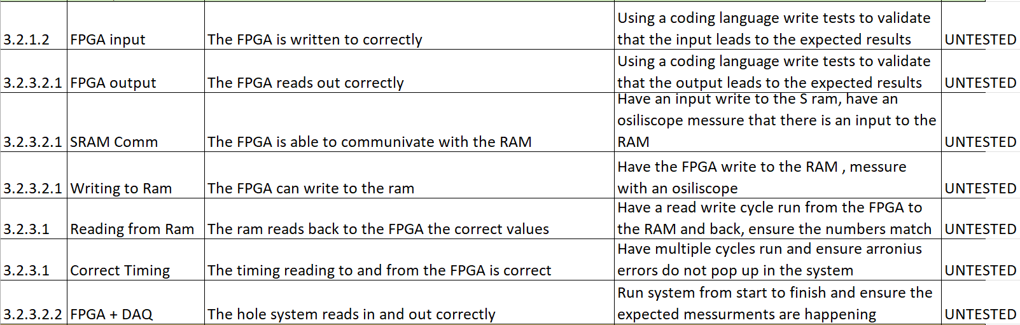
FPGA Validation Plan

Slide 19
Bipolar Circuitry Execution Plan
DAC | Sep-25 | Oct-2 | Oct-9 | Oct-16 | Oct-23 | Oct-30 | Nov-6 | Nov-13 | Nov-20 | Nov-27 | Dec-4
Schematic Design
Order DAC Integrated Circuit
Order Output Circuitry Parts
First PCB Design with 1CH
Solder and Test Board
Update as Necessary

Slide 20
Bipolar Circuitry Validation Plan
Paragraph # | Test Name | Success Criteria | Methodology | Status
3.2.3.2.1 | DAC Output | DAC outputs the expected unbuffered current. | The DAC will receive a digital signal and output the unbuffered current. | UNTESTED
3.2.3.2.2 | I/V Converter | I/V converter changes the current from the DAC to a voltage | I/V converter will receive the current from the DAC and output a voltage. | UNTESTED
3.2.3.2.2 | DAC + I/V | Integrated DAC and I/V to output the expected waveform | The I/V converter will output the waveform from the DAC output current. | UNTESTED
3.2.3.3 | Voltage Regulator | A 10V voltage reference is outputted | The correct voltage reference of 10V is provided to the DAC | UNTESTED

Slide 21
Android Application – Remaining Tasks
Freeform Mode
Export
Bluetooth

Slide 22
Microcontroller – Remaining Tasks
Solder PCB
Program Dev kit and implement on actual microcontroller
Establish Bluetooth connection
Ability to import data points
Export data points to FPGA
Set clock rate

Slide 23
FPGA – Remaining Tasks
Solder PCB
Program the FPGA
Read the input from the Microcontroller
Store the data points
Output the data into the DAC

Slide 24
Bipolar Output Circuit – Remaining Tasks
Receive final parts and board
Solder the PCB
Figure out how to use the AD2 and test the board

Slide 25
Looking Ahead to 404
Fully integrate all subsystems together
Order final PCBs
Establish a power system
Validate and test whole system
Enclosure design and fabrication for PCBs

